Slide 1
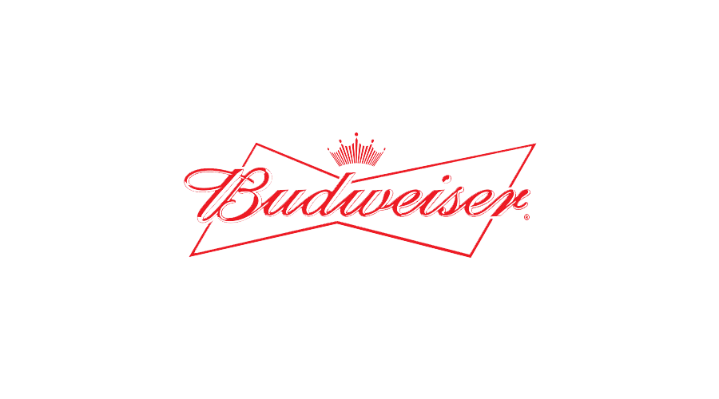


Beer & Breweries
Case Study
Prepared by:
Erika Dupond
Victoria Hernandez
Waleed Amer

Slide 2
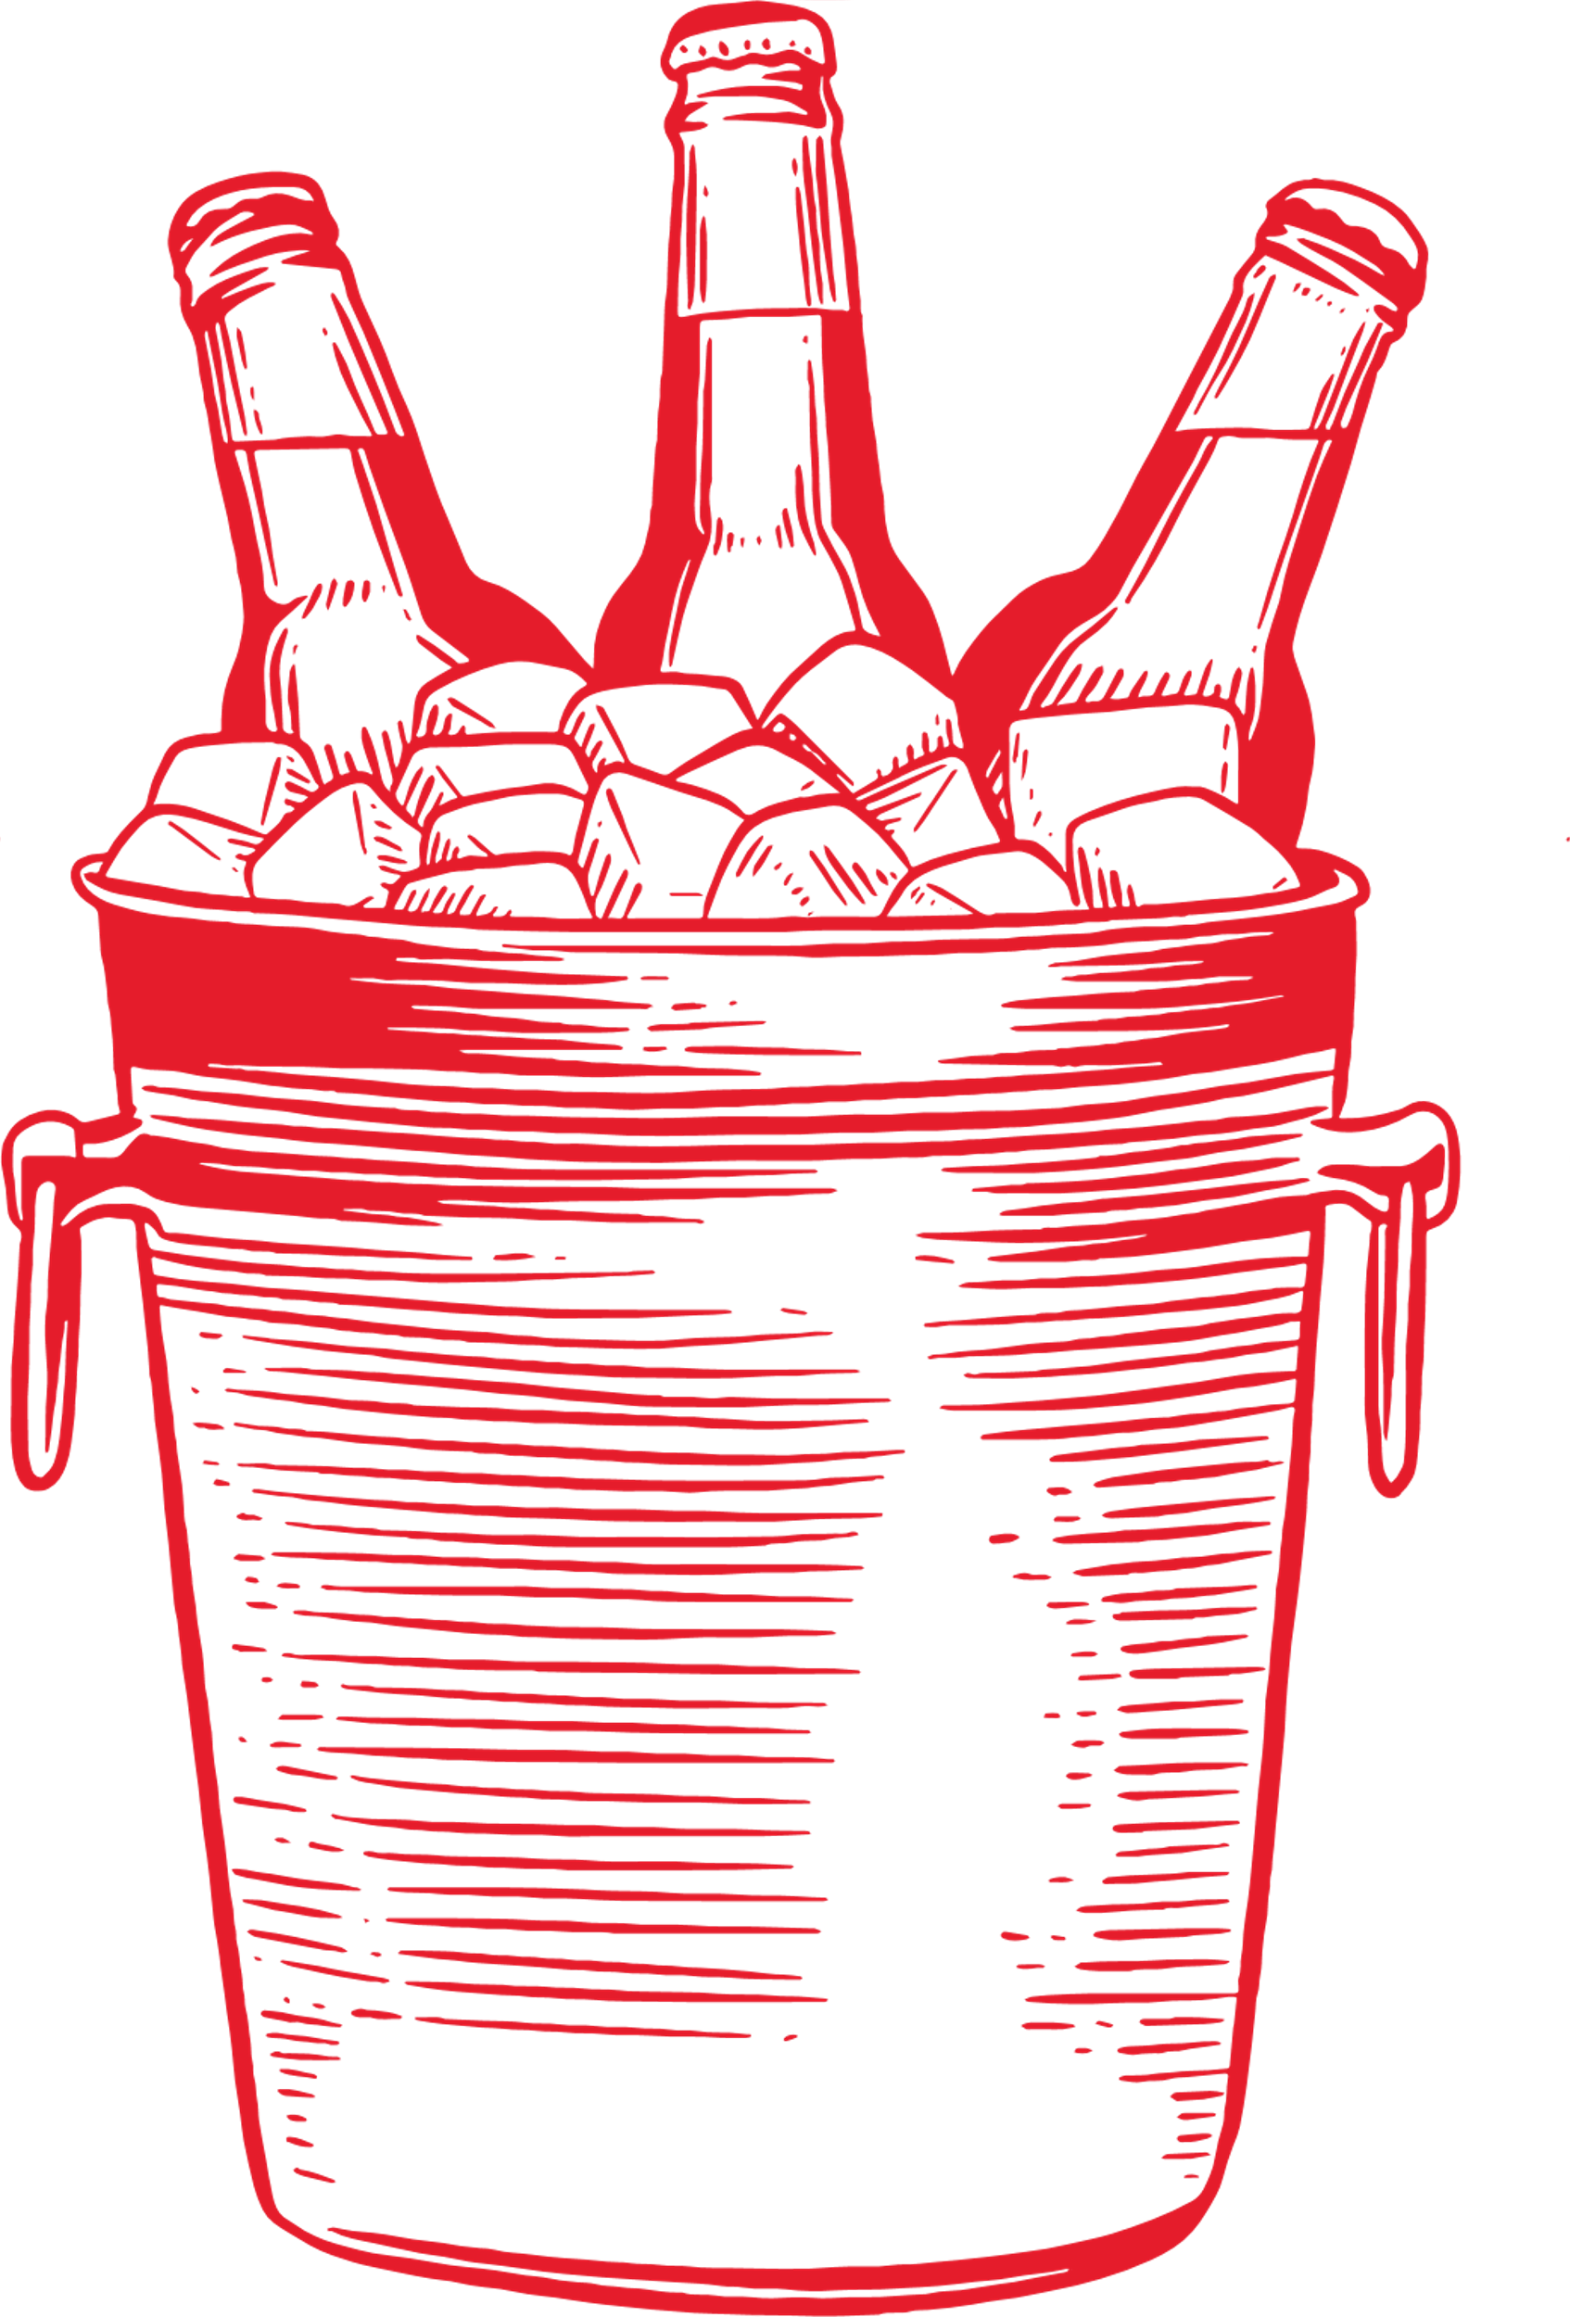
Discussion Topics:
Introduction
How many breweries are present in each state?
Median alcohol content and international bitterness unit for each state.
Which state has the maximum alcoholic (ABV) beer? Which state has the most bitter (IBU) beer?
Summary statistics, distribution of the ABV variable and missing values.
Relationship between the bitterness of the beer and its alcoholic content.
Question and Answer

Slide 3

Introduction
We have undertaken a comprehensive analysis of two important datasets that provide a detailed snapshot of the brewing industry.
The first dataset encapsulates a wealth of information on 2,410 U.S. craft beers, covering aspects such as their alcohol by volume (ABV), International Bitterness Units (IBUs), and beer style. This data offers valuable insights into the popularity of various beer styles, the correlation between ABV and IBUs, and potential market trends.
The second dataset provides records on 558 U.S. breweries, including their location and size. This dataset will allow us to understand geographical distribution, market saturation, and opportunities for expansion.
By cross-referencing these datasets, we can identify patterns and trends that could inform Budweiser's strategic decisions.
Our goal is to present these findings in a clear and impactful manner, focusing on the implications of the data rather than the technicalities of the analysis. We trust that these insights will contribute significantly to shaping Budweiser's future strategies. We thank you for your time!
Notes:
We have undertaken a comprehensive analysis of two important datasets that provide a detailed snapshot of the brewing industry. The first dataset encapsulates a wealth of information on 2,410 U.S. craft beers, covering aspects such as their alcohol by volume (ABV), International Bitterness Units (IBUs), and beer style. This data offers valuable insights into the popularity of various beer styles, the correlation between ABV and IBUs, and potential market trends.
The second dataset provides records on 558 U.S. breweries, including their location and size. This dataset will allow us to understand geographical distribution, market saturation, and opportunities for expansion. By cross-referencing these datasets, we can identify patterns and trends that could inform Budweiser's strategic decisions.
Our goal is to present these findings in a clear and impactful manner, focusing on the implications of the data rather than the technicalities of the analysis. We trust that these insights will contribute significantly to shaping Budweiser's future strategies. Thank you for your time, and we look forward to discussing our findings with you.

Slide 4
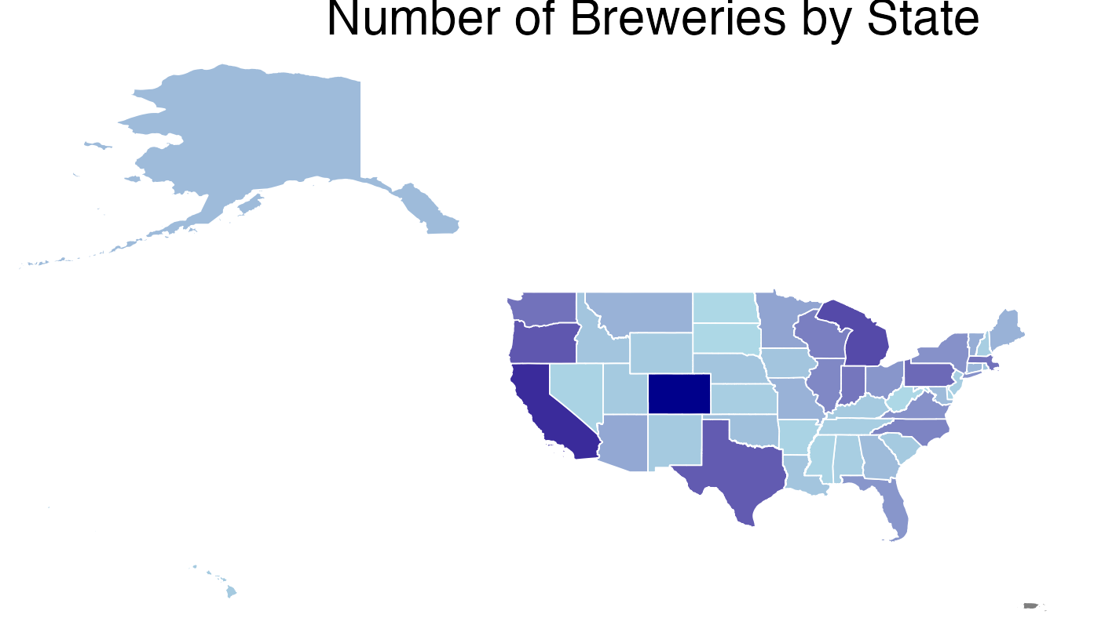
How many breweries are present in each state?
The states with the most breweries are Colorado, California, and Michigan with 47,39, and 32 breweries respectively.
The states with the lowest number of breweries are North Dakota, South Dakota and West Virgina with 1 brewery each.

Slide 5
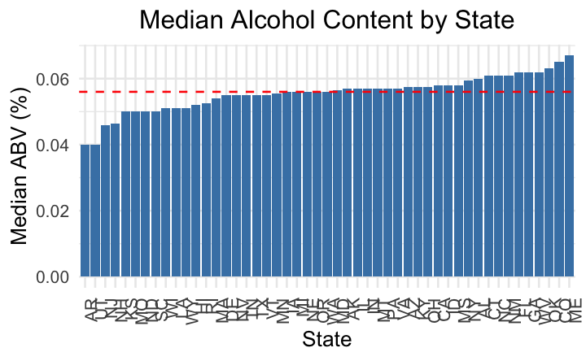
The dataset contains 2410 observations, with some missing values present in the ABV and IBU columns.
After cleaning, the data shows a minimum ABV of 0.001, a maximum of 0.128, and a median of 0.056.
The medians for both ABV and IBU vary significantly across states, indicating diverse beer profiles nationwide.

Slide 6
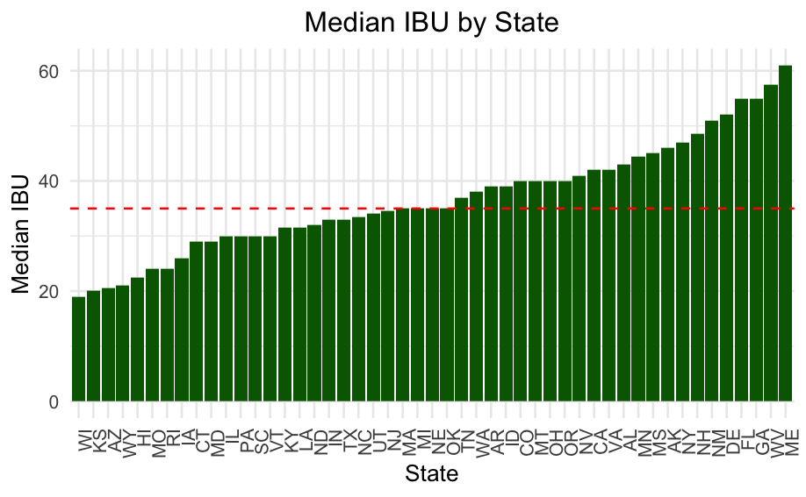
The IBU ranges from 4 to 138, with a median bitterness level of 35.
The state producing the beer with the highest alcohol content (ABV) is Kentucky (KY).
Oregon (OR) leads in terms of the most bitter beer (highest IBU).

Slide 7
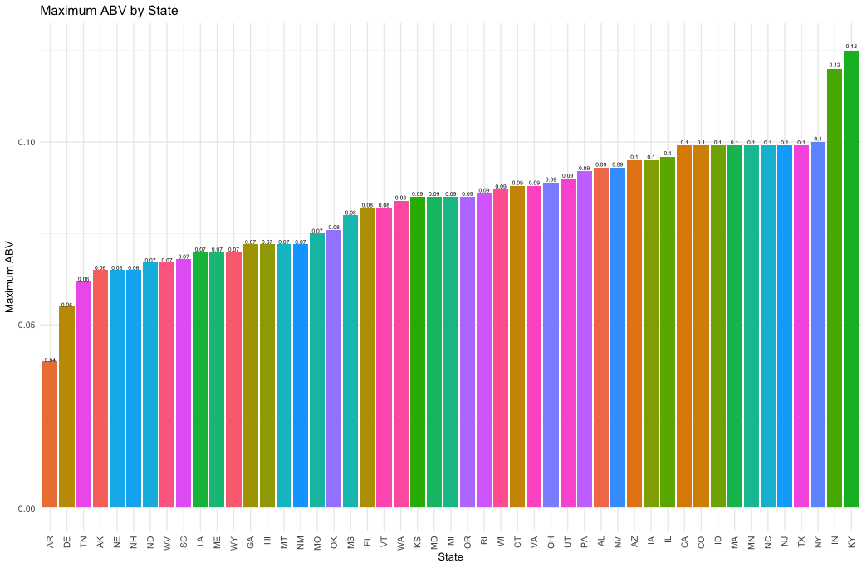
Which state has the maximum alcoholic (ABV) beer?
Our analysis revealed the states producing the beer with the highest alcohol (ABV) and bitterness (IBU) levels. These findings could guide consumers' choices and influence brewers' strategies.
The state with highest ABV is Kentucky followed by Indiana.
This information was extracted using the maximum value in each respective photo (ABV and IBU), pointing us directly to the state associated with these values.
The output provided us with the states producing the beer with the highest alcohol content and bitterness level based on the data we had. Please note that results can vary with different or more updated data.

Slide 8
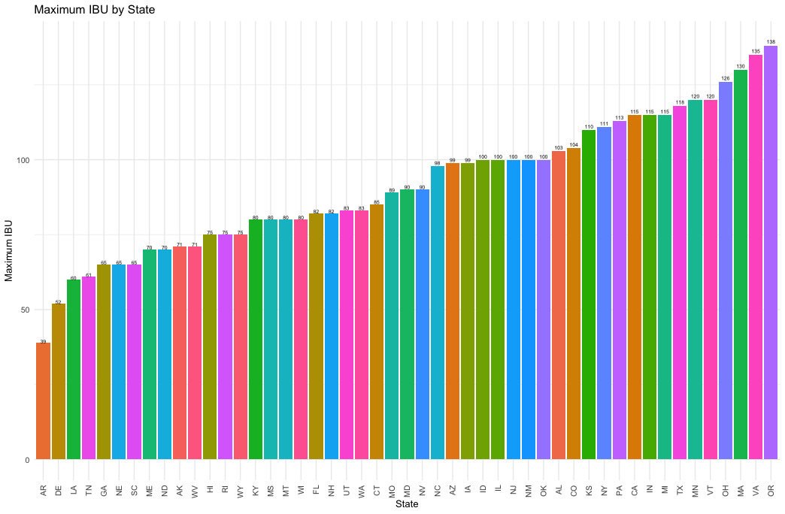
Which state has the most bitter (IBU) beer?
Oregon has the highest IBU and is followed by Virgina.

Slide 9
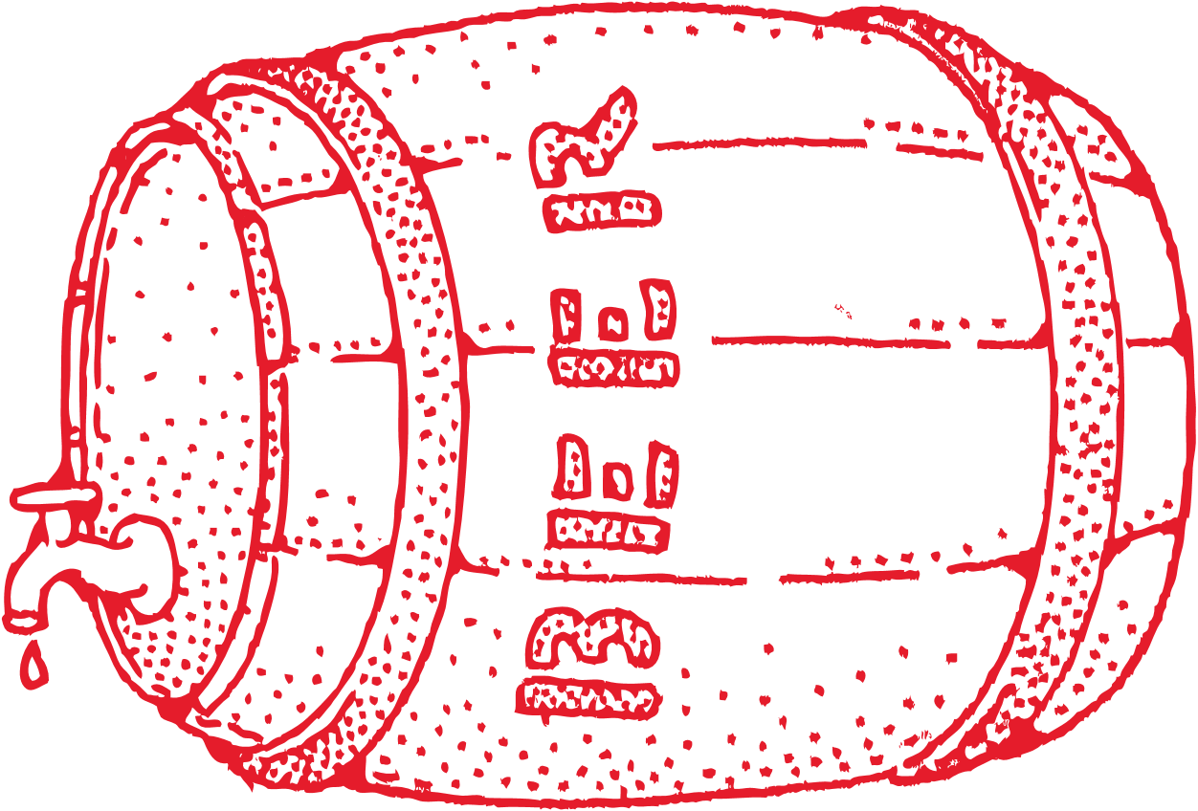
Summary statistics, distribution of the ABV variable and missing values.
Through an analysis of our beer dataset, we've identified key insights into the Alcohol by Volume (ABV) and International Bitterness Units (IBU). The ABV ranges from 0.1% to 12.8%, with the majority of beers sitting around 5.6%. However, the average ABV is slightly higher at 5.98%, indicating the presence of some significantly stronger beers. When it comes to bitterness as measured by IBUs, the median value is 35, but the mean is 42.71, showing that some beers have a considerably high bitterness level. A regional analysis highlights Kentucky as the producer of the beer with the highest ABV, while Oregon leads with the most bitter beer. It's important to note that these findings are based on our current dataset, and may not represent all beers. We also handled missing data points responsibly; specifically, 62 instances where the ABV was not recorded were excluded from the analysis. These insights could be valuable in shaping marketing strategies and understanding regional taste preferences.

Slide 10

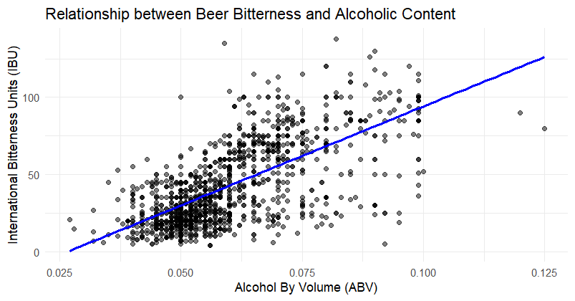
Relationship between the bitterness of the beer and its alcoholic content.
Based on the scatter plot there is an apparent positive correlation between the bitterness of the beer (International Bitterness Units or IBU) and its alcoholic content (Alcohol By Volume or ABV). This means that as the ABV increases, the IBU also tends to increase.
The trend line, which ascends from left to right, supports this observation, indicating that beers with higher alcohol content may also be more bitter.
However, it's important to note that correlation does not imply causation. While the data suggests a relationship, it doesn't prove that higher alcohol content causes increased bitterness.
Further statistical analysis would be required to validate this relationship.

Slide 11
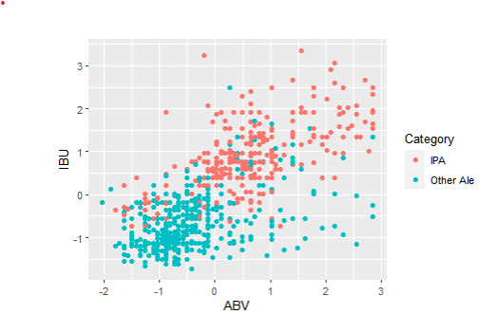
Difference between IPA and Other Ale types with respect to ABV and IBU levels.
We did a comparison between IPA and Other Ale types by cross-validating using the ABV and IBU levels.
After going through a K-Nearest Neighbors (KNN) classification method, we calculated the confusion matrix based off the filtered dataset of just IPAs and Other Ales with ABV and IBV data.
The KNN method's table (shown on the right) resulted in 62 true positives for "IPA" categories and 99 true positives as "Other Ale" categories. From this table, we calculated the accuracy percentage which was 83.4%.
Predicted
 | IPA | Other Ale
IPA | 62 | 14
Other Ale | 18 | 99
Actual

Slide 12
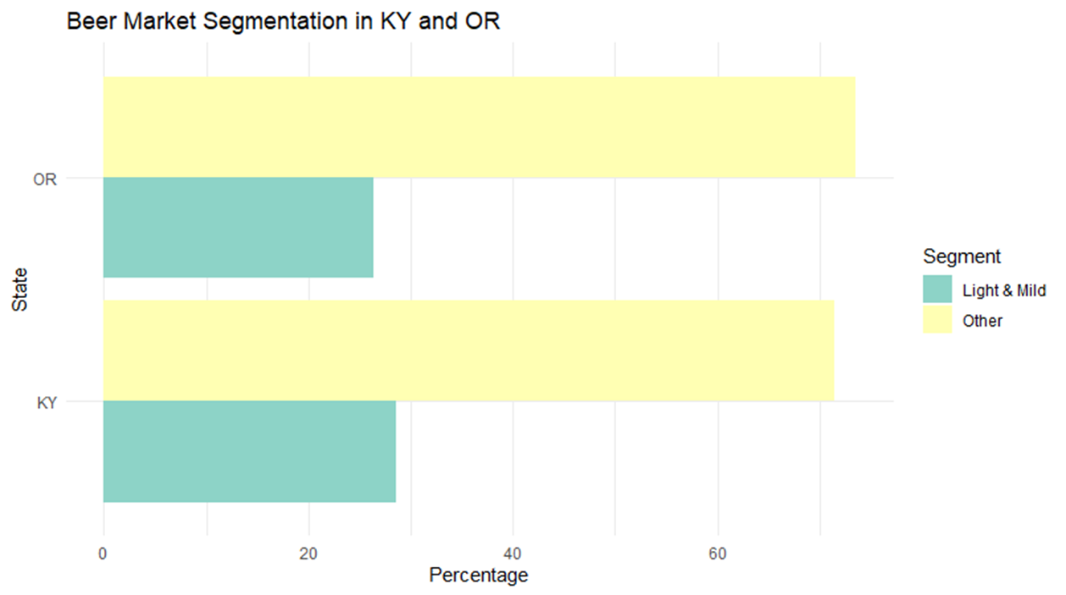
Beer market segmentation between states
From the data we have analyzed, we find that in Kentucky (KY), 28.6% of beers fall into the "Light & Mild" category, while a significant 71.4% are placed in the "Other" category. In Oregon (OR), the distribution is somewhat similar with 26.4% being "Light & Mild" and a substantial 73.6% categorized as "Other". This provides evidence of a potential preference for beers with higher ABV and IBU in these states, as the "Other" category likely encompasses "Standard & Balanced" and "Strong & Bitter" segments.
This trend aligns with broader market dynamics. The craft beer segment, known for its unique and often locally-inspired flavors, has seen considerable growth, now accounting for 24.6% of the $115 billion U.S. beer market¹. Meanwhile, domestic beers, including Budweiser, made up around 69% of U.S. beer consumption in 2022². However, the total beer volume in the U.S. experienced a negative compound annual growth rate (CAGR) of 2% between 2017 and 2022³.
The combination of these trends suggests a shifting landscape where consumers are increasingly attracted to craft beers. Thus, Budweiser's investment in local brands within KY and OR could be a strategic move to tap into this burgeoning market segment.
Looking towards the future, projections indicate an upward trajectory for the beer market. The U.S. beer market is forecasted to grow by 1.98% from 2024 to 2028⁴, and the North American beer market is expected to reach USD 214 billion by 2029, growing at a CAGR of 4.39%⁵.
Drawing from these statistics and their implications, the evidence would suggest that Budweiser stands to gain by investing in local brands in states such as KY and OR. This approach would not only allow Budweiser to diversify its product portfolio but also position the brand to capitalize on the growing demand for more varied and locally-inspired flavors. In doing so, Budweiser could potentially increase its market share in the evolving U.S. beer industry.
Footnotes
https://www.brewersassociation.org/statistics-and-data/national-beer-stats/ ↩
https://www.statista.com/topics/1654/beer-industry-in-the-united-states/ ↩
https://www.theiwsr.com/key-trends-for-the-us-beer-market-in-2023/ ↩
https://www.statista.com/outlook/cmo/alcoholic-drinks/beer/united-states ↩
https://www.mordorintelligence.com/industry-reports/north-america-beer-market ↩

Slide 13
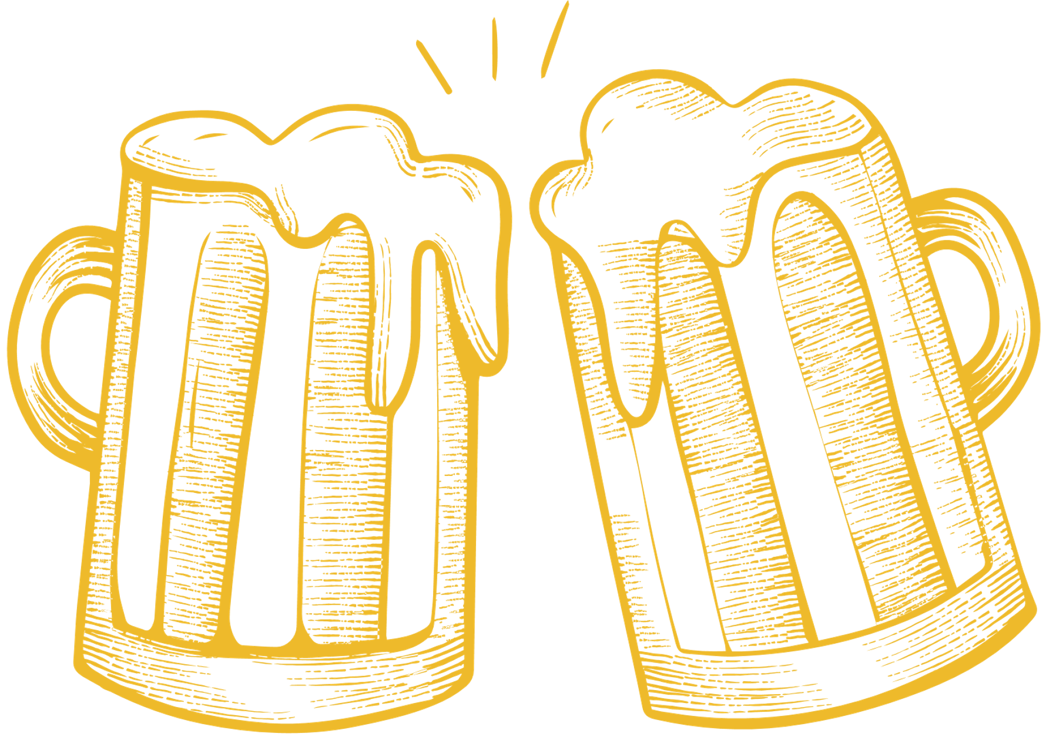
Thank You!
We may take your questions now

